Slide 1

Prepared by DataScape
OURSPACE
Kaung Nyo Lwin
Truong Vuong
Aymen Zubair Qureshi
Cassandra Chang
1

Slide 2



DataScape
OURSPACE - NOSQL
OurSpace is an online platform that connects people looking for shared spaces with owners who have spaces to rent, such as co-working spaces, meeting rooms or private offices.
Space owners can list their space with details like location, size , price , facilities or Rental rates. customers can search, book, and review spaces in just a few clicks. The platform handles payments securely and earns a small 3% service fee on each booking.
2

Slide 3


IMPORTANCE
Reasons why we think this is important (and interesting!):
Space owners can rent out empty offices and earn extra income.
Many people work from home or freelance and need short-term office spaces.
The platform recommends spaces based on what customers like and need.
Gives smart recommendations, shows simple reports, and improves based on customer feedback to make the platform easy to use.
3

Slide 4

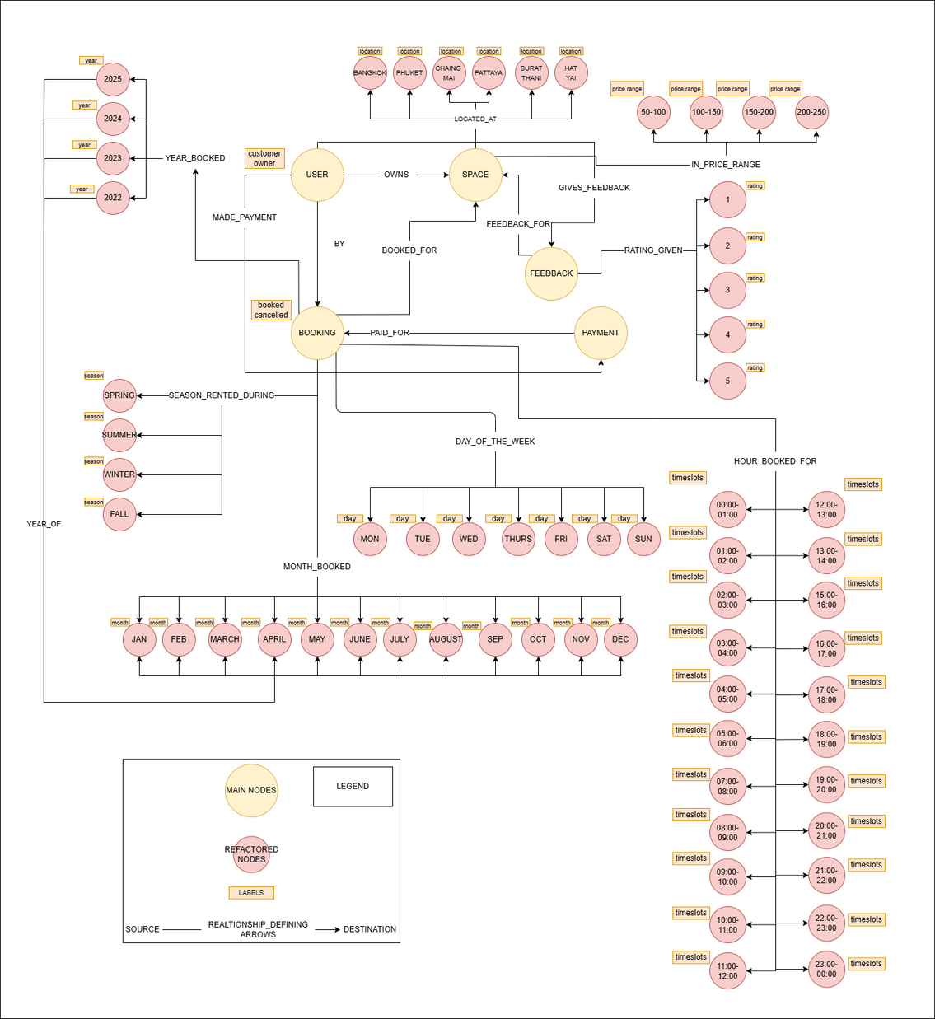
DATA MODEL
USER:
ID
Name
Email
Phone
Address
Prefered Price Range
Number of bookings
Total Spent
CreatedAt
UpdatedAt
FEEDBACK:
ID
Reviews
CreatedAt
Payment:
Amount
TransacId
Bank
Status
CreatedAt
UpdatedAt
SPACE:
SpaceID
SpaceName
Address
Size
numRooms
hourlyRate
HalfdayRate
FulldayRate
Status
Remark
Rating
CreatedAt
UpdatedAt
BOOKING:
Booking Id
Booking Date
Space Price
System Fee
Total
CreatedAt
UpdatedAt
REFACTORED LABELS:
Timeslot
Day
Month
Year
Season
Rating
Price_Range
Location
All refactored labels except “rating” and “location” have the properties “Number of Bookings” and “Total Spent Amount” updated whenever a booking is made.
4

Slide 5
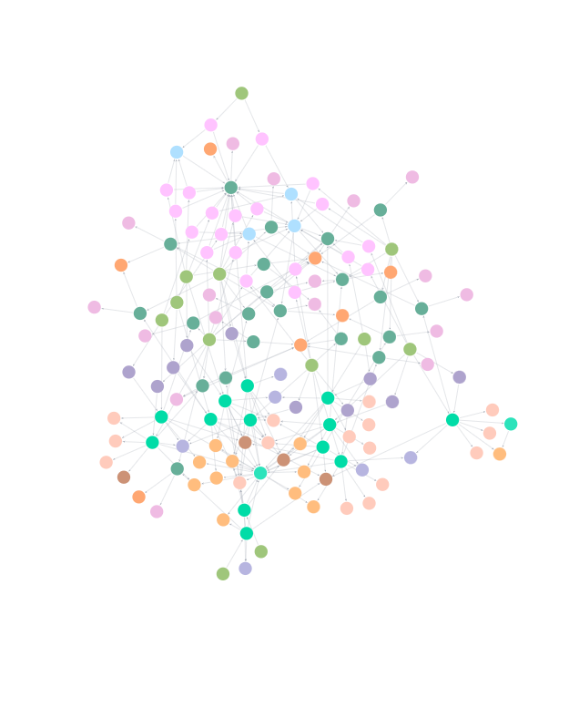
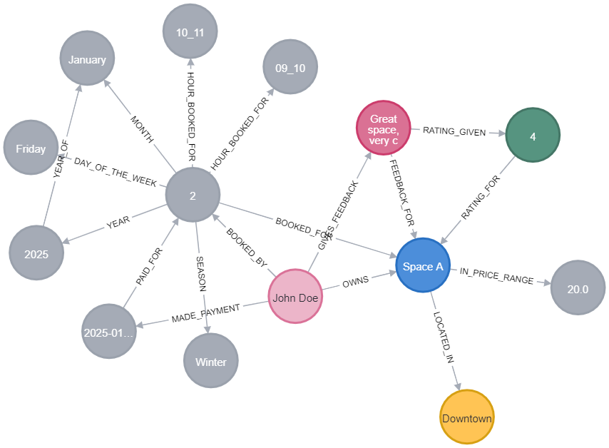
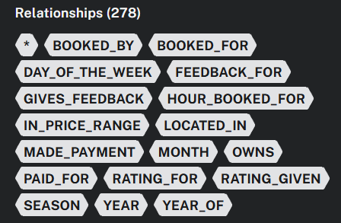
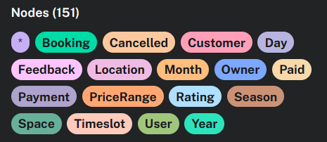
DATA MODEL IMPLEMNTATION
5

Slide 6
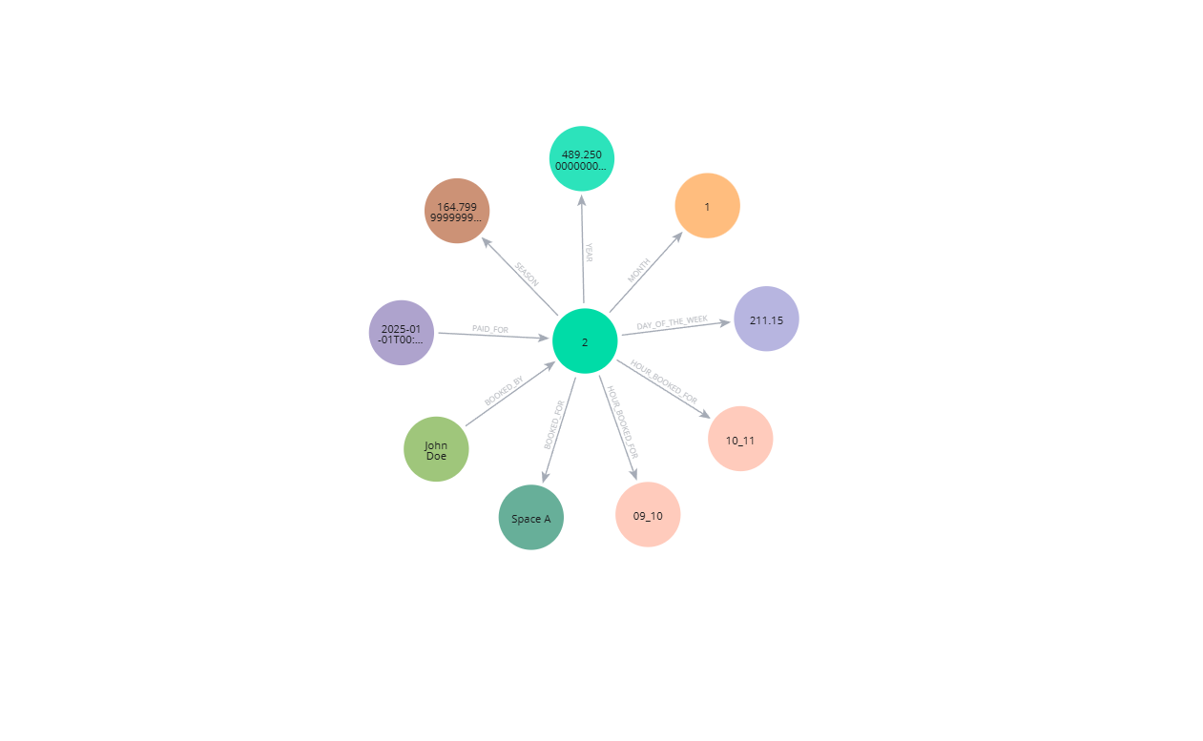
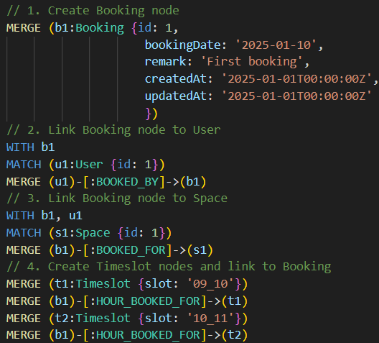
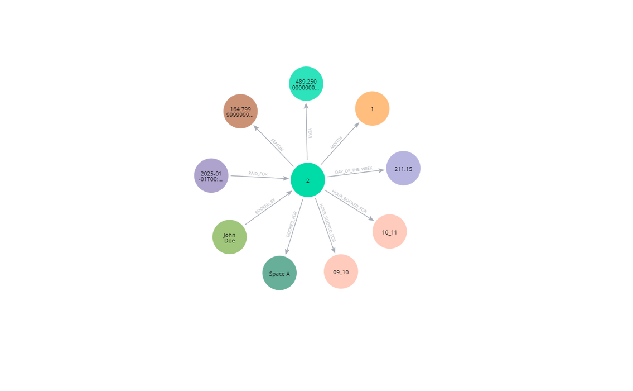
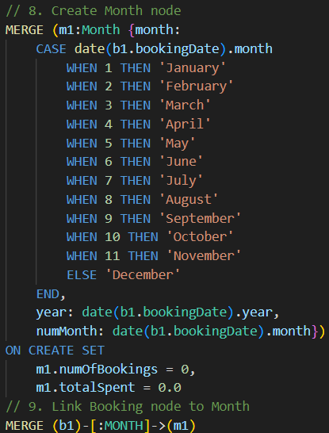
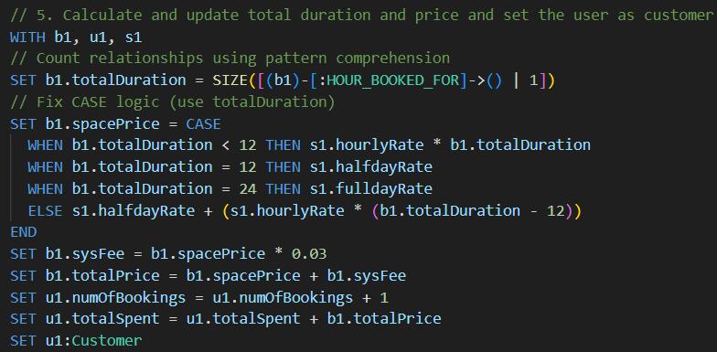
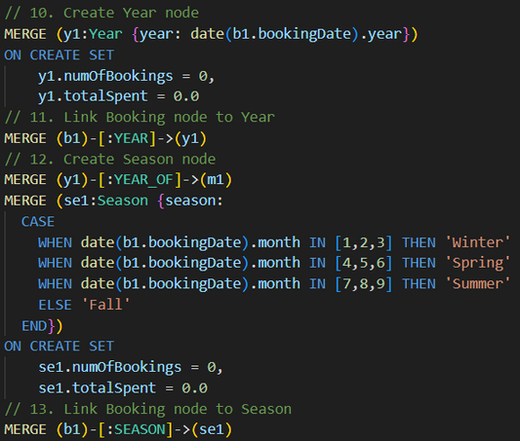
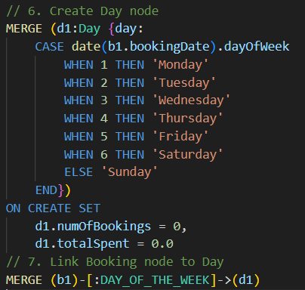
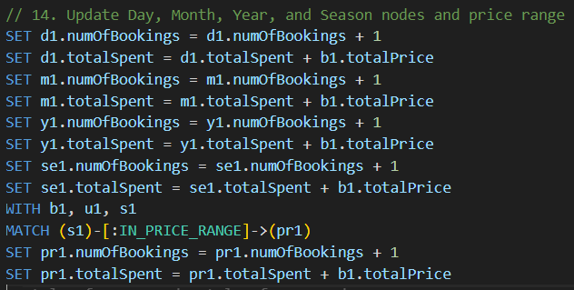
BOOKING
Kaung Nyo Lwin
6

Slide 7
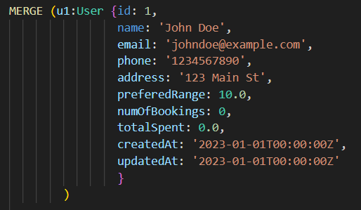
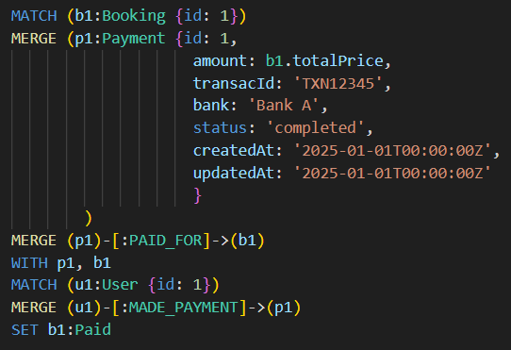
OTHER TRANSACTIONS
Kaung Nyo Lwin
User Registration:
Paying the charges:
7

Slide 8
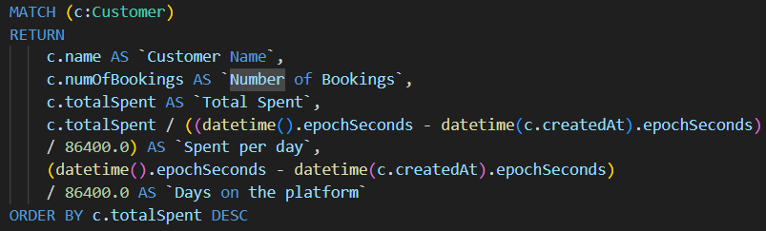
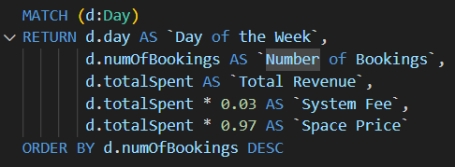
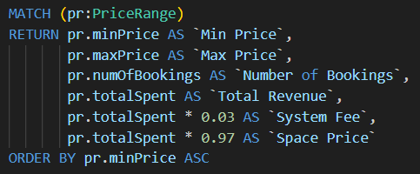
Kaung Nyo Lwin
IMPORTANT DATA QUERIES AND REPORT
Most spenders Report: This report retrieves the most spending customers based on their rental activities of the specified period. The output will contain the customer name, spent amount, average spending per day and how many days the users have been on the platform.
Popular Day of the Week report: This generates a report to see the most busy days of the weeks of the specified period. The output will contain the day of the week, the total number of bookings, price, and fee.
Rental Report by price range: This generates a report that shows the number of bookings, spending amount, and total fee by defined price ranges
8

Slide 9
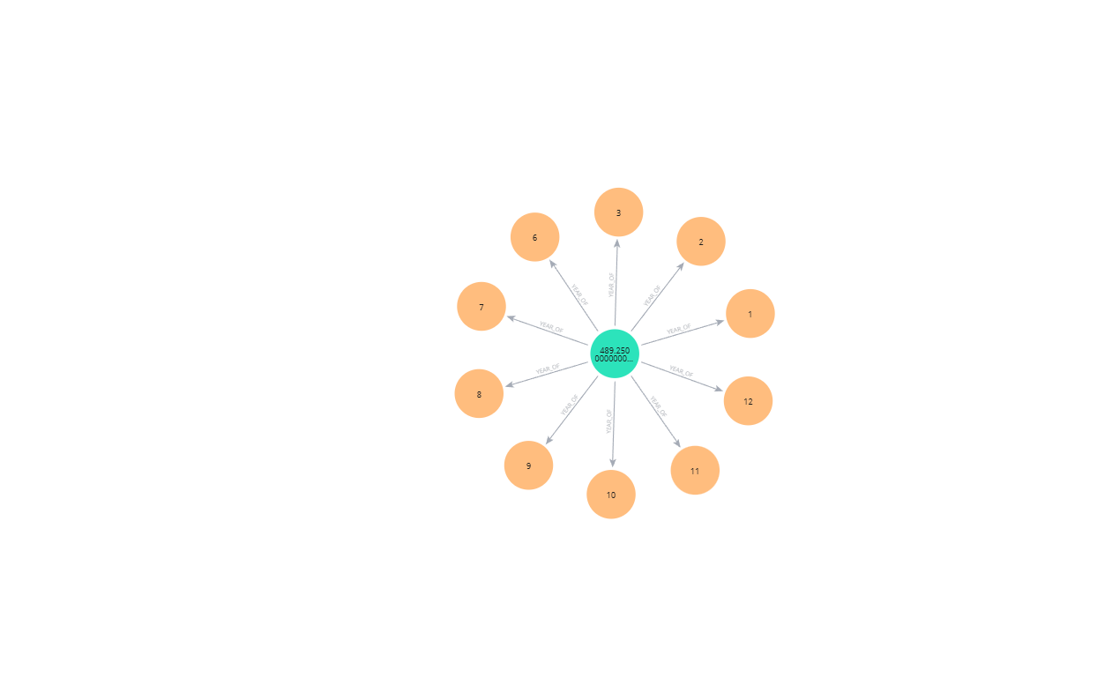
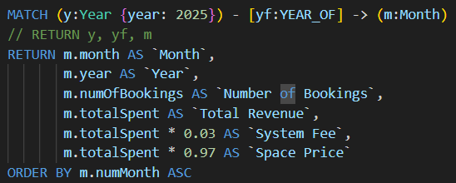
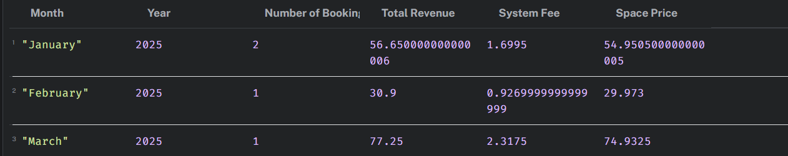
Kaung Nyo Lwin
MONTHLY REVENUE REPORT
This generates a revenue report based on monthly detailed rental transactions of the specified period. The output will contain the month, the year, the price, the fee, and the total amount.
9

Slide 10
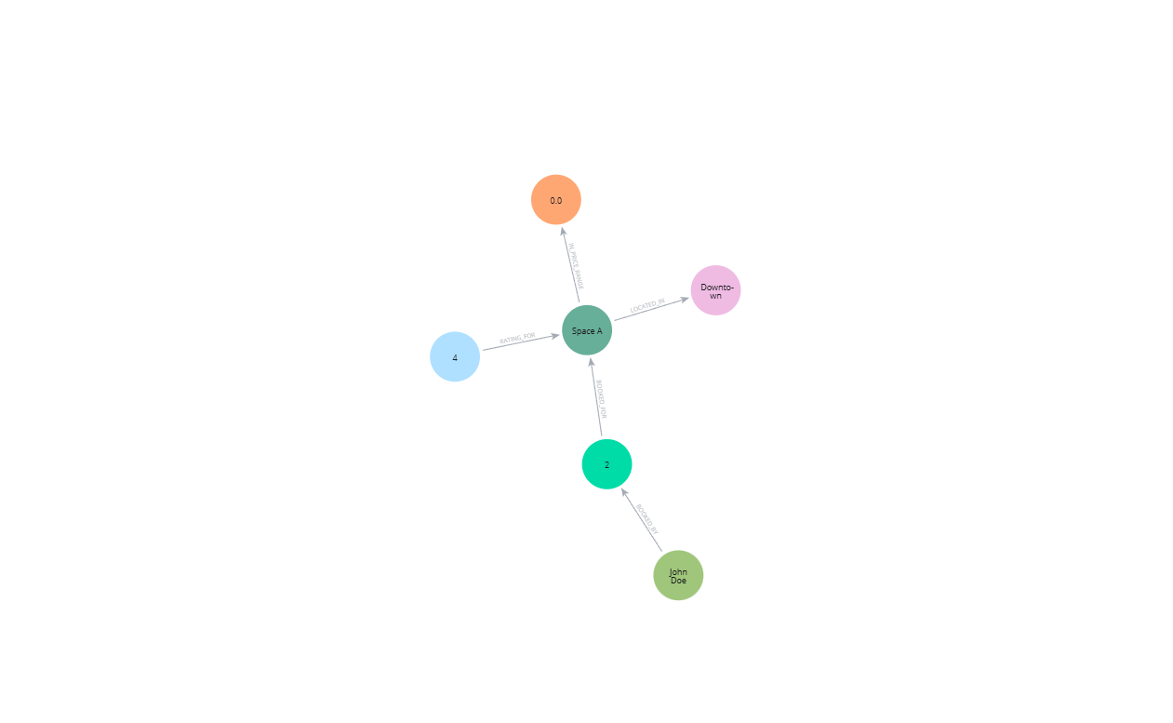
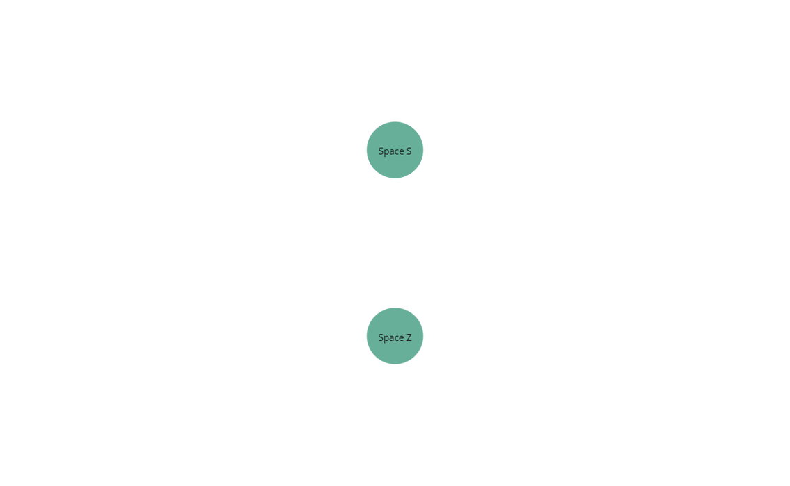
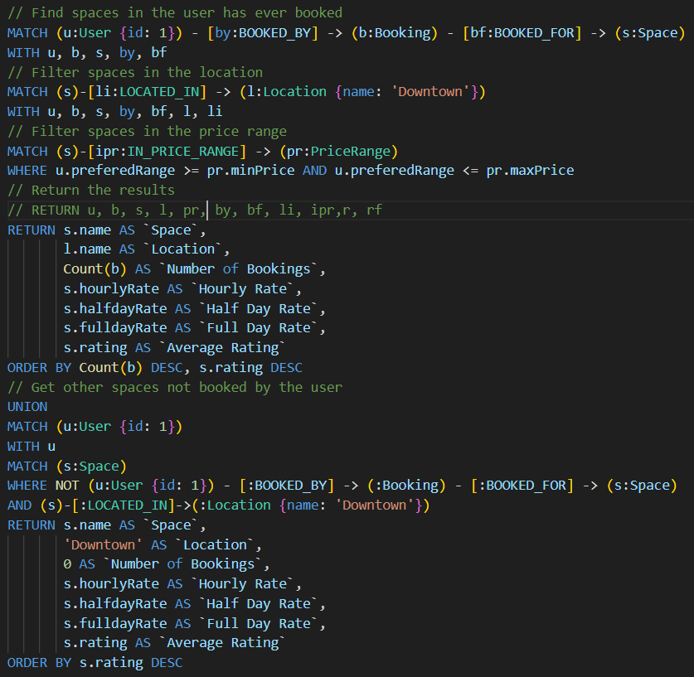
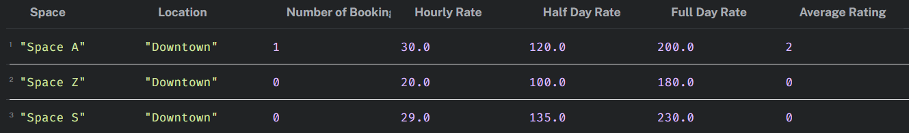
Kaung Nyo Lwin
SPACE RECOMMEDATION QUERY
This query retrieves a list of available spaces based on the user’s information such as preferred price range and history of booking by taking the input (location) of user
10

Slide 11
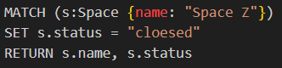

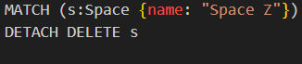
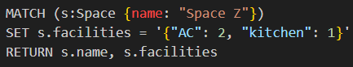
TRANSACTIONS
Truong Vuong
Space Status Update:
Space owners can update the availability status of their listed spaces (e.g., open, closed, available, unavailable or temporarily unavailable for maintenance).
4
Space Removal:
The platform administrators can remove a space listing temporarily or permanently due to violations, safety concerns, or legal issues.
5
Change Number of Facilities:
Space owners can change the number of specific facilities available in their listed spaces (e.g., increase or decrease the number of chairs, tables, etc.).
6
11

Slide 12
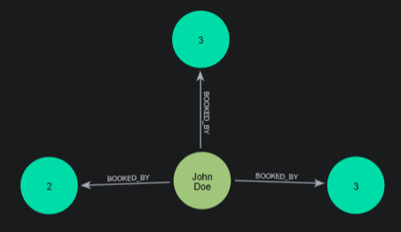
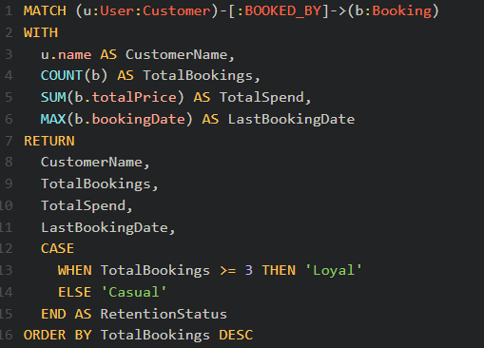
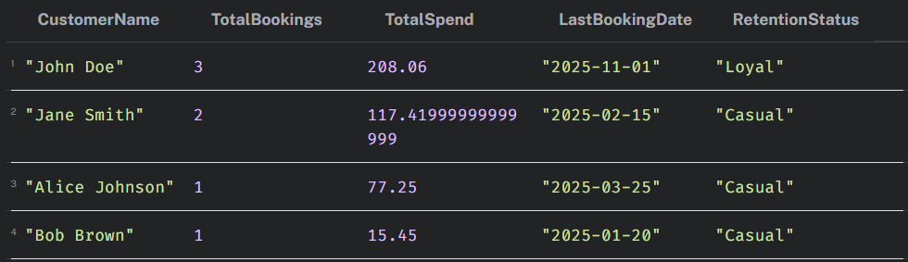
Truong Vuong
IMPORTANT DATA QUERIES AND REPORT
Customer Retention Report: Calculates the total bookings, total spend, last booking date, and retention status for each customer. Retention status can be based on the frequency of bookings (e.g., the number of TotalBokings is greater than or equal to 3 bookings => "Loyal").
12

Slide 13
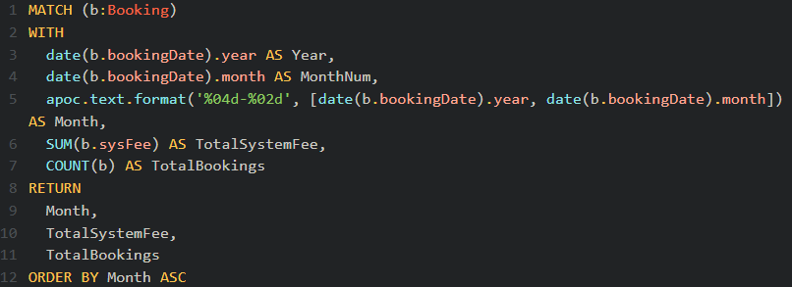
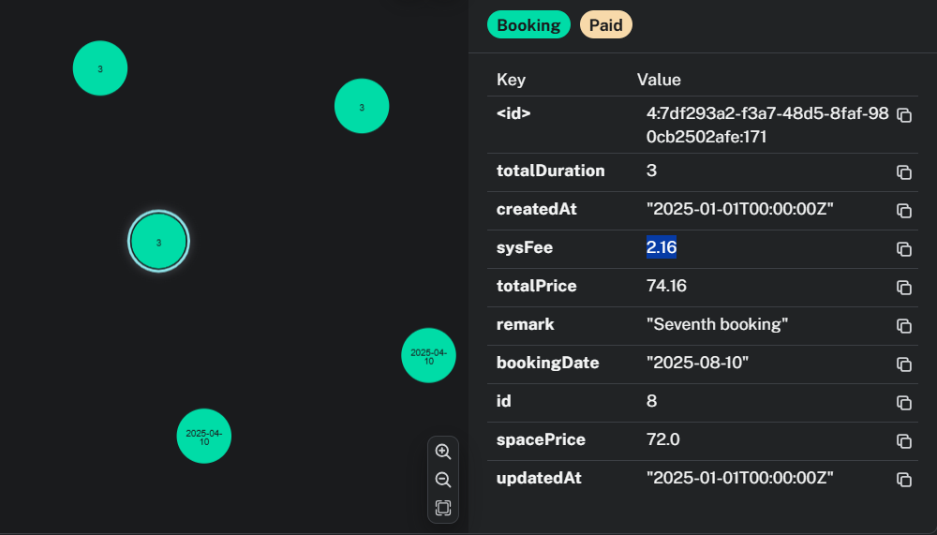
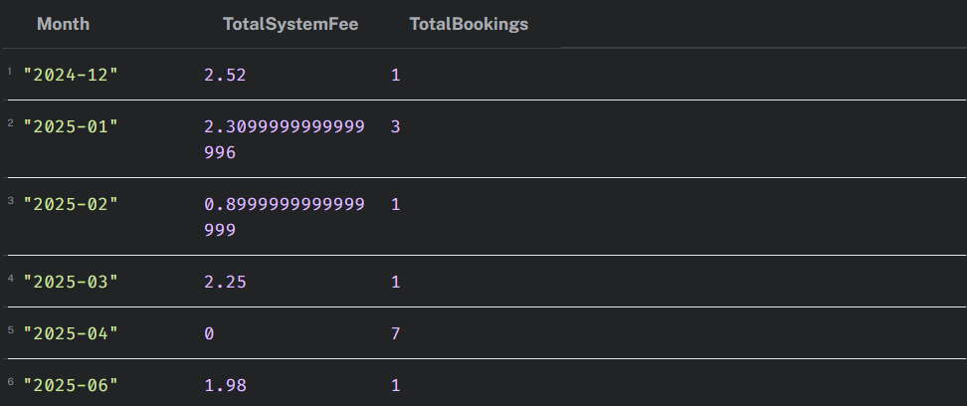
Truong Vuong
IMPORTANT DATA QUERIES AND REPORT
Total System Fee: calculates the total system fee by month, providing insights into monthly revenue trends specifically for System. This helps us monitor our revenue streams from booking transactions.
13

Slide 14
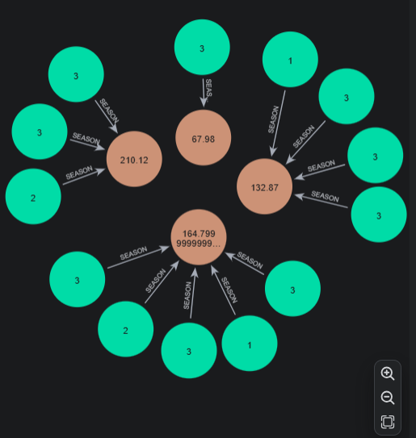
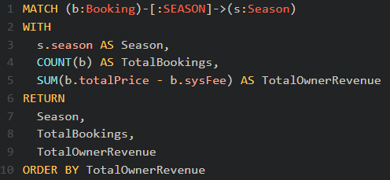
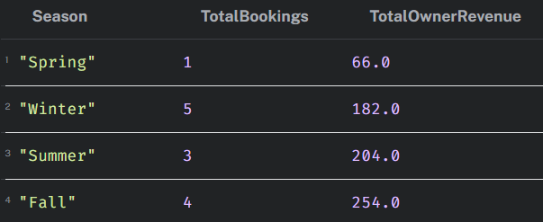
Truong Vuong
IMPORTANT DATA QUERIES AND REPORT
Booking Trends by Season Report: Analyzes seasonal demand and calculates the TotalOwnerRevenue, which represents the total revenue for space owners, excluding the sysFee. This helps owners adjust pricing and promotions accordingly.
14

Slide 15
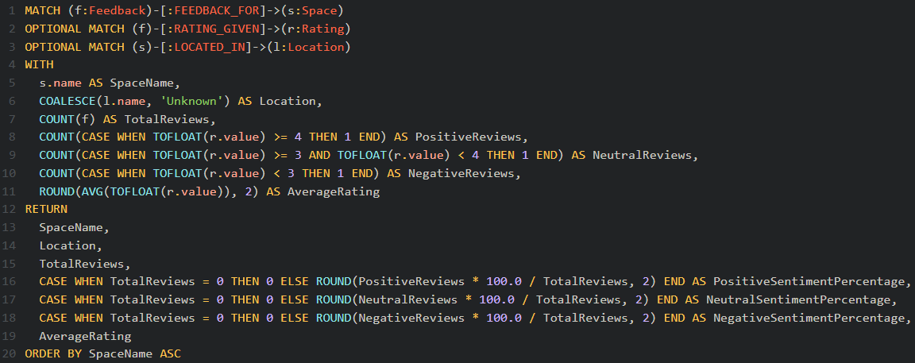
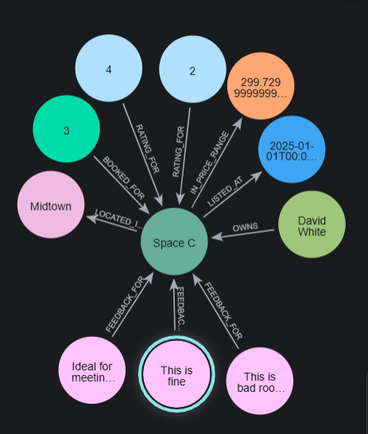
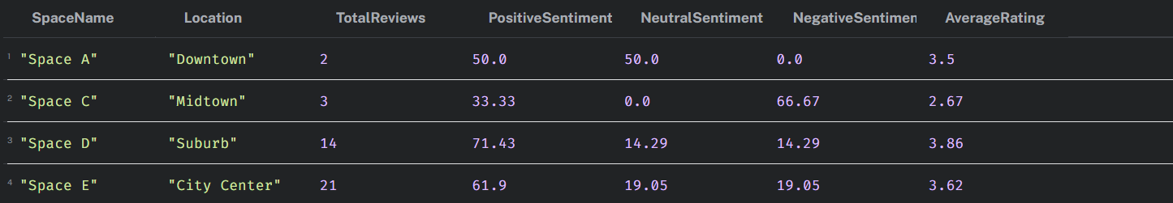
Truong Vuong
IMPORTANT DATA QUERIES AND REPORT
Customer Feedback Sentiment Report: This query joins feedback data with the corresponding space information, then groups reviews by space. Reviews are categorized into positive (rating ≥ 4), neutral (≥ 3 and < 4), or negative (< 3), and the query calculates the number and percentage of each sentiment type, along with the average rating. The report provides insights into customer experience and highlights areas needing improvement.
15

Slide 16
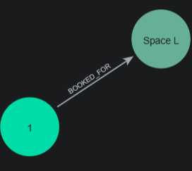
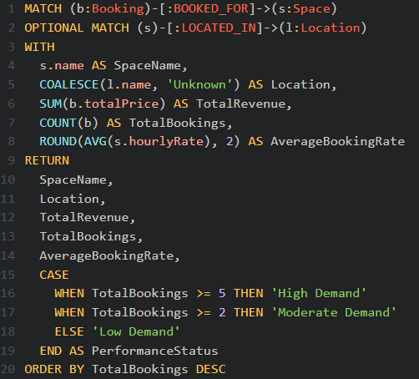
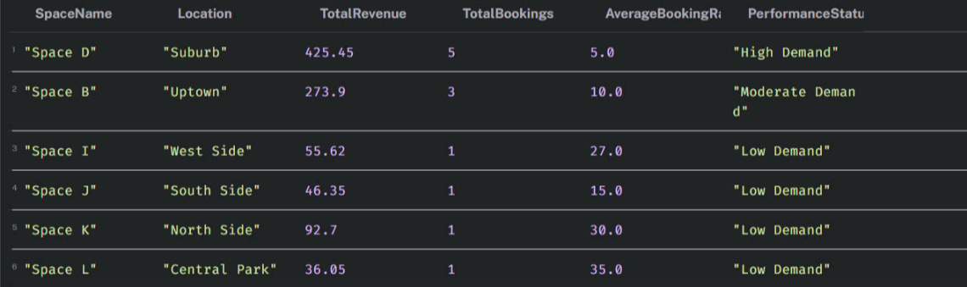
Truong Vuong
IMPORTANT DATA QUERIES AND REPORT
Space Demand and Performance Report: The query gathers booking data for each space, calculating total revenue, total bookings, and average hourly rate. Based on booking volume, each space is classified as having "High", "Moderate", or "Low Demand." This report supports performance analysis, helps optimize space utilization, and informs pricing or promotional adjustments.

Slide 17
Cassandra Chang
TRANSACTIONS
Feedback Submission:
Information containing the feedback from the customer will be stored in the feedback collection as a document containing elements such as rating and review.
OPERATION: INSERTING A FEEDBACK FOR A SPACE
7
Rental Rate Adjustments:
Space owners can modify the rental rates (hourly, half-day, or full-day) for their listed spaces. This will be reflected onto the space collection.
OPERATION: UPDATING THE RENTAL RATES FOR A SPACE
8
User Profile Updates:
Users (owner or customer) can update their personal details (e.g., name, contact info, preferences). This update is only possible if the individual is a user of the platform.
OPERATION: UPDATING USER PROFILE DETAILS
9
17

Slide 18
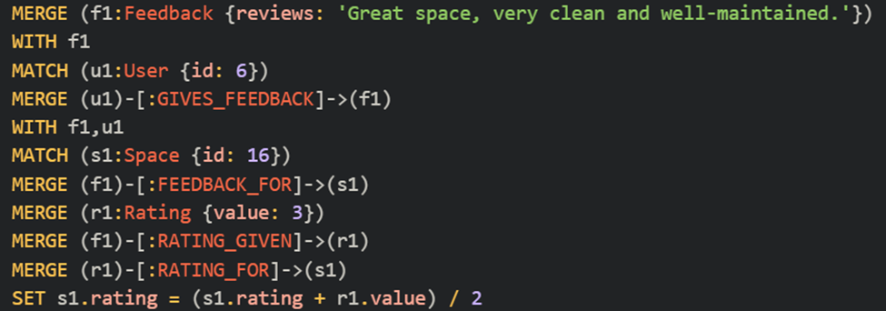
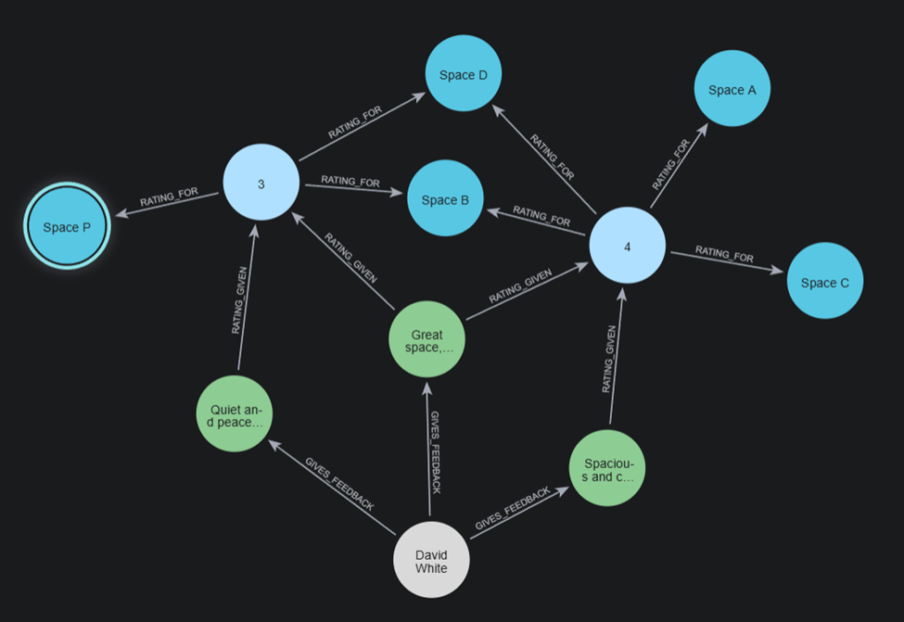
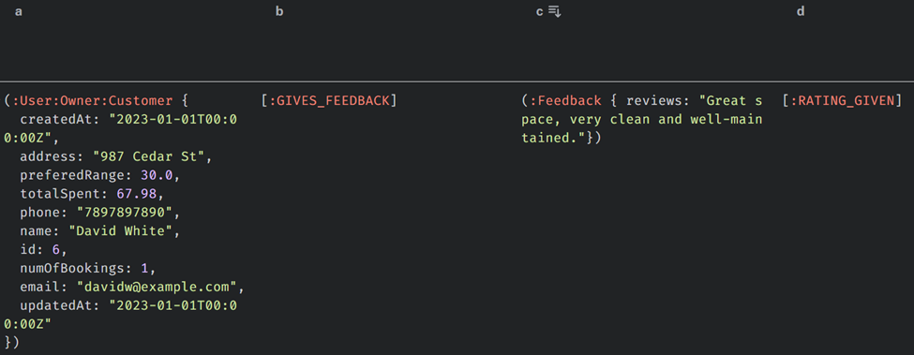
TRANSACTIONS
FEEDBACK SUBMISSION
Query:
Graph Result:
Tabular Result:
18

Slide 19
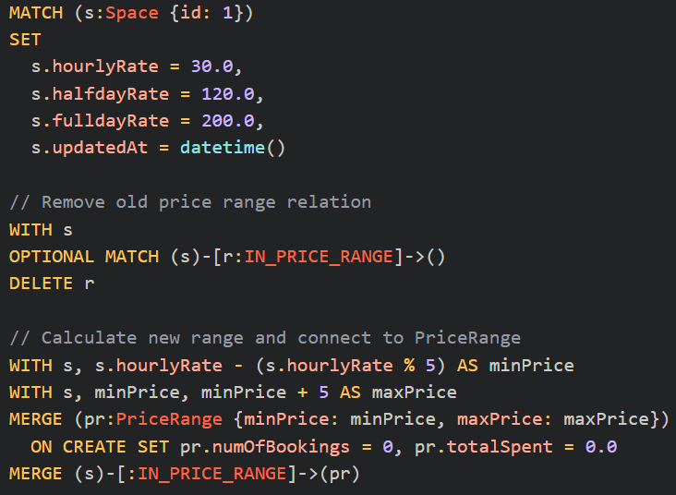
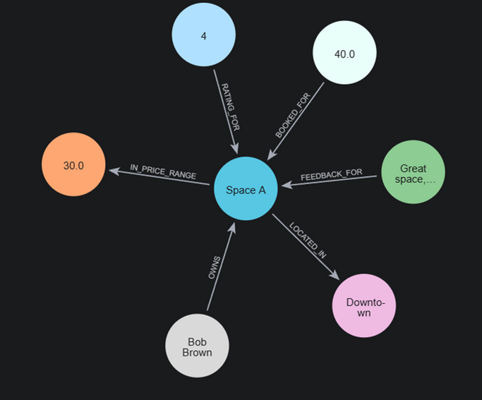
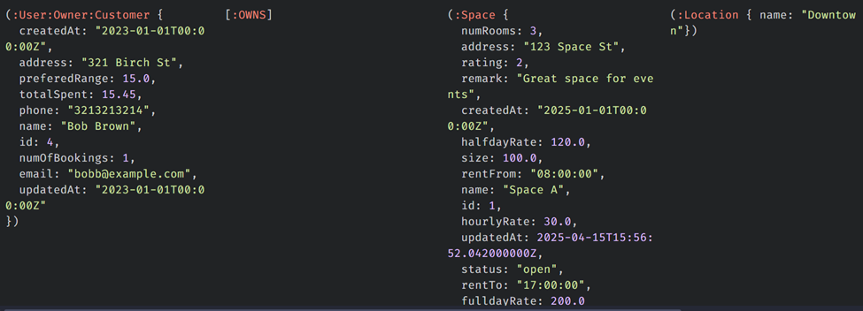
TRANSACTIONS
RENTAL RATE ADJUSTMENT
Query:
Graph Result:
Tabular Result:
19

Slide 20
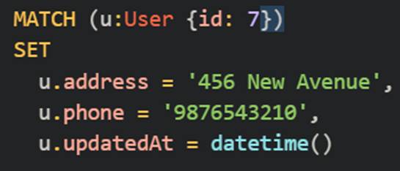


TRANSACTIONS
USER PROFILE UPDATE
Query:
Graph Result:
Tabular Result:
20

Slide 21
Cassandra Chang
IMPORTANT DATA QUERIES AND REPORT
Longest Duration Booking Ever:
Report tells us who the higher spender is for each space. This was the system can gain insights for incentives or promotions to attract the spender again.
Customer Booking History:
This report fetches all bookings made by a specific customer, including space details, booking dates, facilities used, and total charges.
Space Owner Earnings Report:
This report shows earnings for a specific space owner, grouped by their spaces, including space name, total bookings, earnings, and platform fees.
Space Utilization Report:
This report helps the user (owner) understand which spaces have not been booked in the a month. This helps the owner get insights about the underperforming units and make changes to it.
Most Frequently Cancelled Spaces
Identify listings with high cancellation counts and update if the owners should be given a warning before flagging them.
21

Slide 22


Cassandra Chang
IMPORTANT DATA QUERIES AND REPORT
Longest Duration Booking Ever:
Report tells us who the higher spender is for each space. This was the system can gain insights for incentives or promotions to attract the spender again.
Customer Booking History:
This report fetches all bookings made by a specific customer, including space details, booking dates, facilities used, and total charges.
22

Slide 23

Cassandra Chang
IMPORTANT DATA QUERIES AND REPORT
Most Frequently Cancelled Spaces
Identify listings with high cancellation counts and update if the owners should be given a warning before flagging them.
23

Slide 24


Cassandra Chang
IMPORTANT DATA QUERIES AND REPORT
Space Owner Earnings Report: This report shows earnings for a specific space owner, grouped by their spaces, including space name, total bookings, earnings, and platform fees.
24

Slide 25


Cassandra Chang
IMPORTANT DATA QUERIES AND REPORT
Space Utilization Report: This report helps the user (owner) understand which spaces have not been booked in the a month. This helps the owner get insights about the underperforming units and make changes to it.
25

Slide 26



TRANSACTIONS
Aymen Zubair Qureshi
Feedback Removal
Allows space owners to review customer feedback and request the removal of inappropriate or misleading reviews.
Feedback:
Query:
Results:
26

Slide 27


TRANSACTIONS
Aymen Zubair Qureshi
New space listing:
The space owner can create a new listing by providing important details of the new space.
Editing the bookings:
The customer can modify/cancel the booking dates.
27

Slide 28



IMPORTANT DATA QUERIES AND REPORT
Retrieve a specific Bookings Details: retrieves specific details of bookings, including the customer's name, the space they booked, the booking date, and the payment, providing a clear overview of the booking information.
Query:
Graph Result:
Tabular Result:
28

Slide 29



IMPORTANT DATA QUERIES AND REPORT
Owner Review Feedback: This query shows the feedback given by users for spaces owned by a specific owner. It helps the owner view ratings and comments to understand user satisfaction and make improvements if needed.
Graph Result:
Query:
Tabular Result:
29

Slide 30


IMPORTANT DATA QUERIES AND REPORT
Most Popular Spaces by Booking Frequency: This query identifies the most popular spaces by counting how often each space has been booked and ranks them accordingly.
Query:
Tabular Result:
30

Slide 31


IMPORTANT DATA QUERIES AND REPORT
Recently listed space: This identifies the most recently listed spaces by filtering spaces based on the owner's name and the listing date, helping to track new space listings.
Tabular Result:
Query:
31

Slide 32


IMPORTANT DATA QUERIES AND REPORT
Popular Booking Time Slots: This query finds the most popular booking time slots by counting how often each time slot was booked.
Query:
Tabular Result:
32

Slide 33
COMPARISON AND CONCLUSION
Model | Benefit | Drawback | Use Cases
Relational | Good for transactions (booking, payment) | Difficult to store semi-structured information such as space and facilities | Booking and Payment
Document | Fast Retrieval using a single document | Data consistency (many update operations to enforce consistency) | Space and Facilities
Graph | Instance relationship (good for complex relationships) | Intensive Write Operations (for data summarization) | Area, Address and Location
Choice -
Relational Database Management System (RDBMS)
33

Slide 34

34

